Slide 1

Customer Shopping Behavior Analysis
Analyzing 3,900 purchases to uncover spending patterns, customer segments, and subscription behavior.

Slide 2

Project Overview & Dataset Summary
Project Goal
Analyze 3,900 purchases to understand spending, segments, preferences, and subscriptions.
Dataset Details
18 columns including demographics, purchase details, and shopping behavior. 37 missing values in Review Rating.

Slide 3
Exploratory Data Analysis (EDA) with Python
01
02
03
Data Loading & Exploration
Missing Data Handling
Column Standardization
Imputed missing 'Review Rating' values using the median of each product category.
Renamed columns to snake_case for improved readability and documentation.
Imported dataset with pandas, checked structure and summary statistics.
04
05
Feature Engineering
Data Consistency & Integration
Created 'age_group' and 'purchase_frequency_days' columns for deeper analysis.
Dropped redundant 'promo_code_used' and loaded cleaned data into PostgreSQL.

Slide 4
Key Performance Indicators
3,900
$59.76
$157,890
$75,191
Total Customers
Average Purchase
Male Revenue
Female Revenue
3.75
Avg Rating

Slide 5


SQL Analysis: Key Business Insights
Revenue by Gender
High-Spending Discount Users
Male customers generated significantly more revenue ($157,890) than female customers ($75,191).
Identified 839 customers who used discounts but still spent above average.
Top 5 Products by Rating
Gloves, Sandals, Boots, Hat, and Skirt received the highest average review ratings.

Slide 6

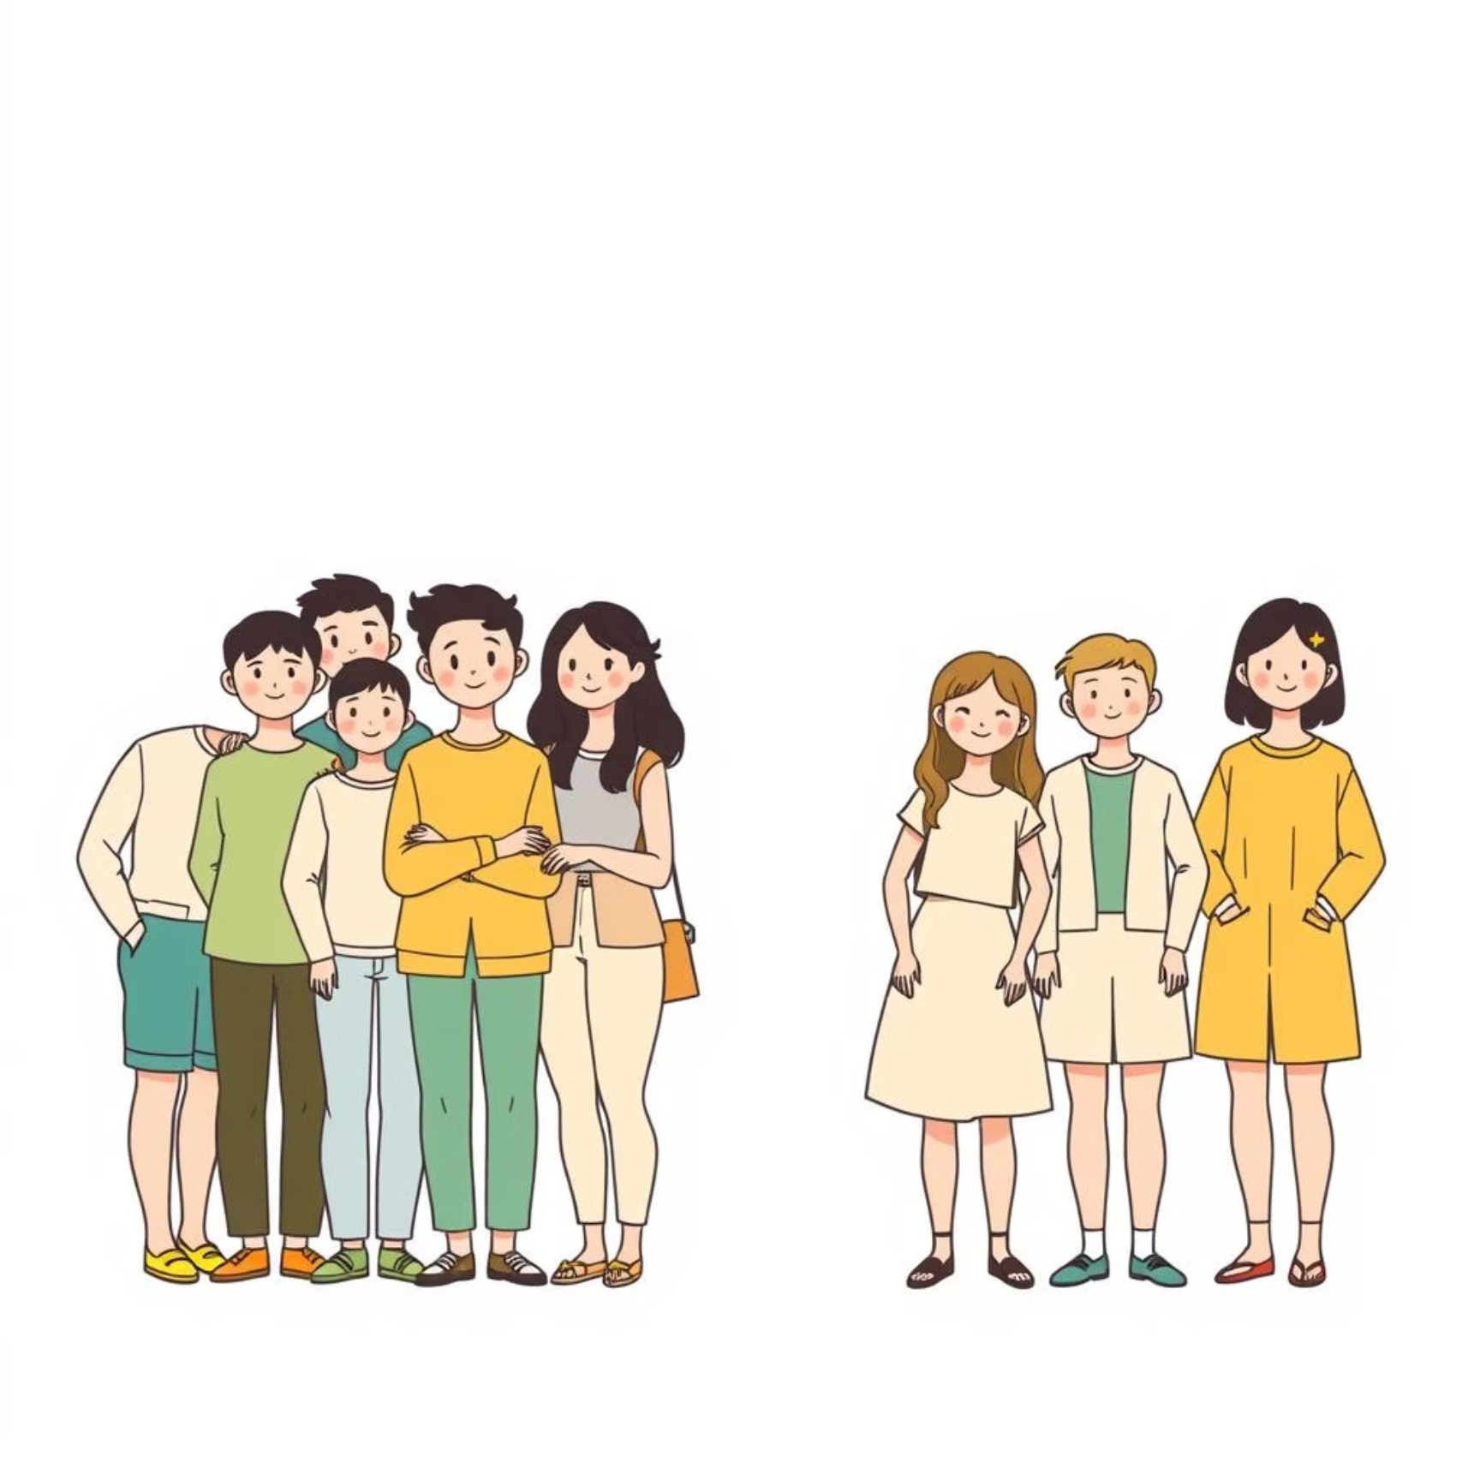
SQL Analysis: Shipping & Subscriptions
Shipping Type Comparison
Subscribers vs. Non-Subscribers
Express shipping users had a higher average purchase amount ($60.48) compared to standard shipping ($58.46).
Non-subscribers (2847 customers) contributed more total revenue ($170,436) than subscribers (1053 customers, $62,645).

Slide 7

SQL Analysis: Product & Customer Focus
Discount-Dependent Products
Customer Segmentation
Hat (50%), Sneakers (49.66%), Coat (49.07%), Sweater (48.17%), and Pants (47.37%) had the highest discount rates.
Customers were segmented into Loyal (3116), Returning (701), and New (83) based on purchase history.
Repeat Buyers & Subscriptions
2518 repeat buyers were non-subscribers, while 958 were subscribers, indicating potential for subscription growth.

Slide 8
Top Products by Category
1
Accessories
Jewelry
171
2
Accessories
Sunglasses
161
3
Accessories
Belt
161
1
Clothing
Blouse
171
2
Clothing
Pants
171
3
Clothing
Shirt
169
1
Footwear
Sandals
160
2
Footwear
Shoes
150
3
Footwear
Sneakers
145
1
Outerwear
Jacket
163
2
Outerwear
Coat
161

Slide 9





Business Recommendations
Boost Subscriptions
Promote exclusive benefits to increase subscriber base.
Customer Loyalty Programs
Reward repeat buyers to foster loyalty and move them to the "Loyal" segment.
Review Discount Policy
Optimize discount strategies to balance sales growth with profit margins.
Targeted Marketing
Focus marketing efforts on high-revenue age groups and express-shipping users.

